Slide 1

Movement and Control of Biomimetic Humanoid Robots
Ben P. Bolen · PhD Defense
November 6, 2026
Notes:
My dissertation develops ways to predict actuator force, compare robot joints with human torque targets, and test sensory control. The research robot serves as an experimental platform for studying how mechanics and neural control work together.
Sources: Portland State University · Agile & Adaptive Robotics Laboratory

Slide 2
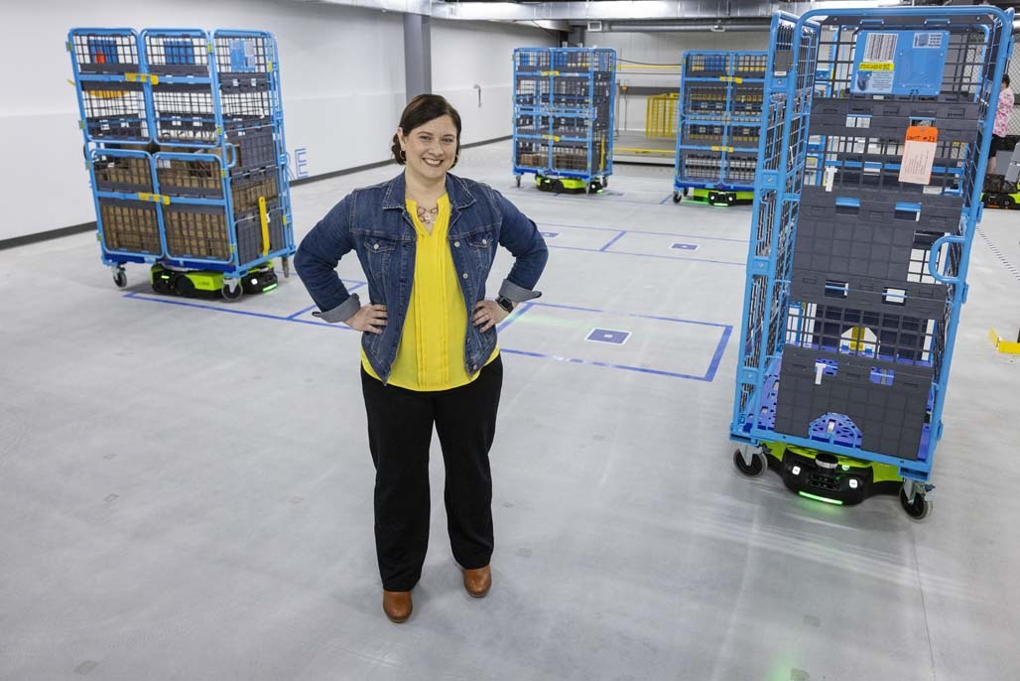
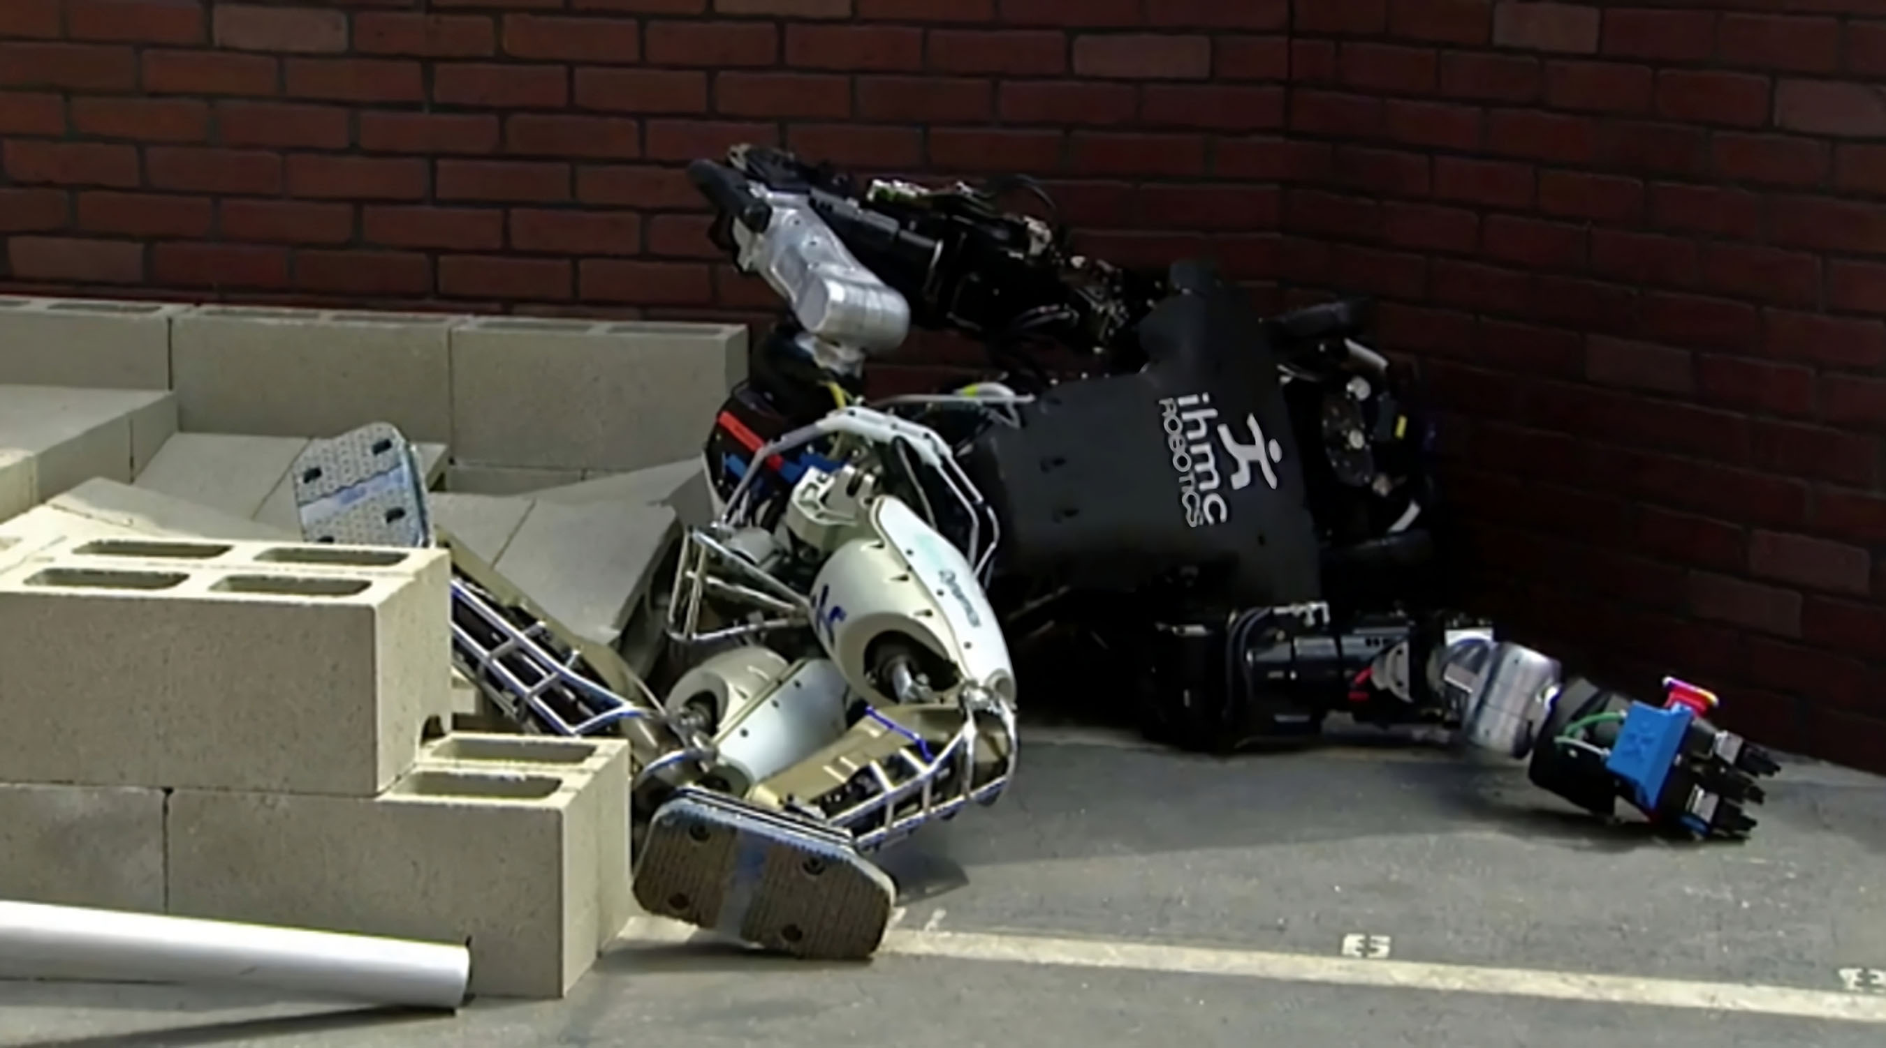
Robots on warehouse floors face different challenges from robots on rubble
Predictable contact
Changing contact and balance
Amazon Robotics; DARPA Robotics Challenge (2015)
2
Notes:
Wheels work efficiently on prepared warehouse floors. Rubble introduces changing contacts and disturbances. These photographs motivate our interest in compliant legs and neural control; they are not a controlled comparison of the two robots.
Sources: Amazon Robotics; DARPA Robotics Challenge (2015)
https://www.aboutamazon.com/news/operations/amazon-robotics-headquarters-tour-westborough-massachusetts
https://newatlas.com/robotics/fast-two-legged-robots-roundup/

Slide 3
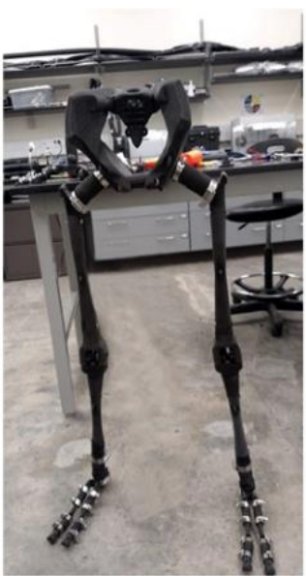
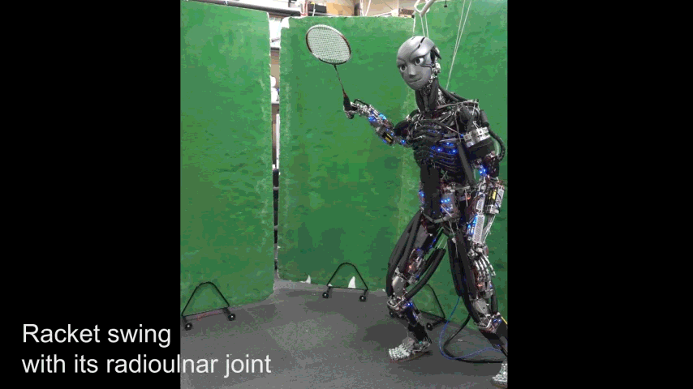
Biomimetic robots let us test mechanics and neural control
Biological mechanisms
Controlled robot experiments
Asano et al. (2016); Bolen and Hunt (2019); Dissertation Ch. 1
3
Notes:
Biology informs robot design, while biomimetic robots let us intervene in mechanics and neural pathways in ways that would be impossible in humans. Better prosthetic and orthotic devices are a later application. Kengoro illustrates physical biomimicry; the AARL leg is our research platform.
Sources: Asano et al. (2016); Bolen and Hunt (2019); Dissertation Ch. 1

Slide 4

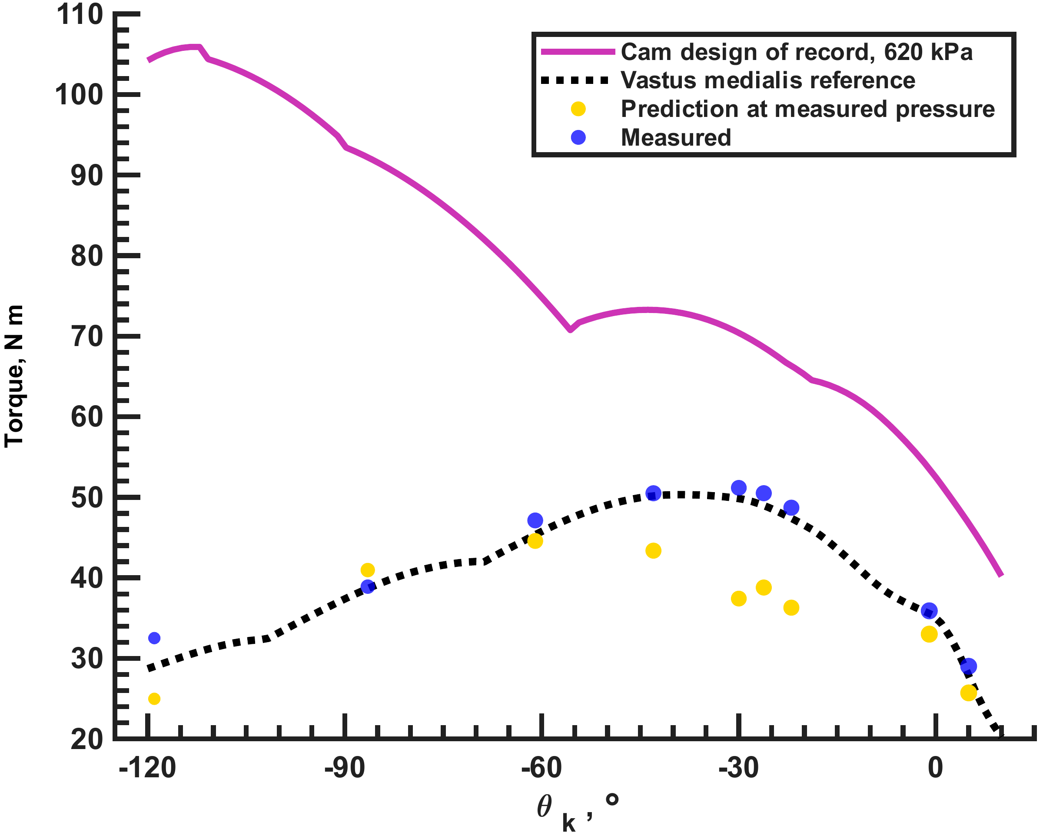
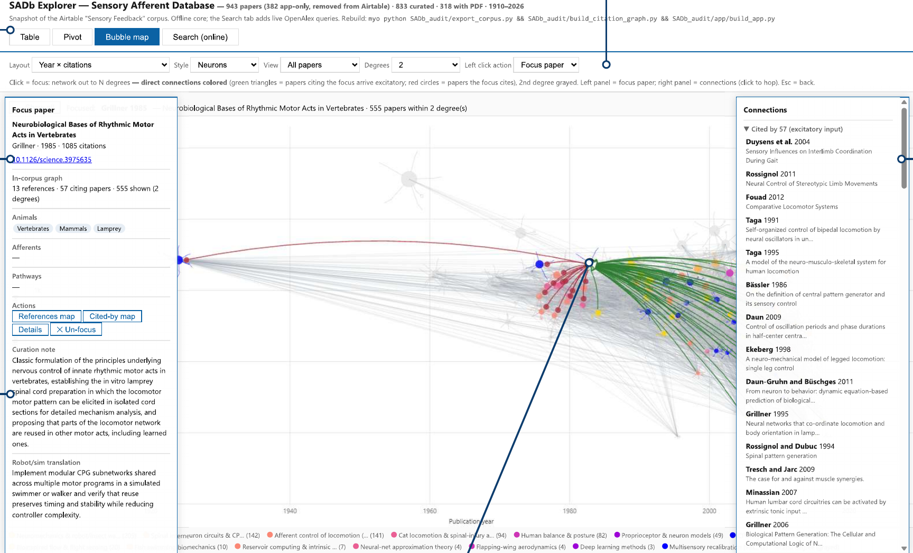
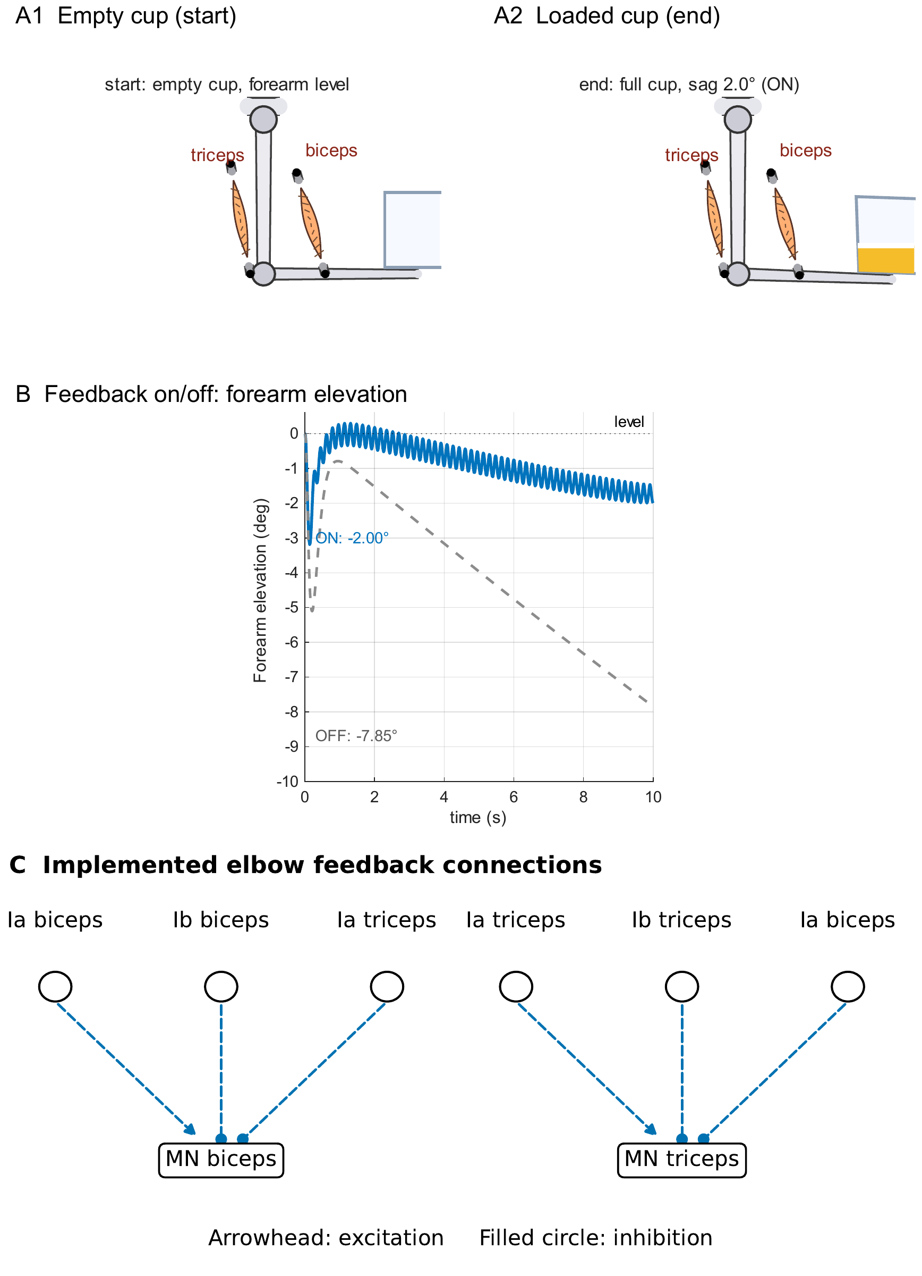
Four knowledge and tool gaps for biomimetic robot research
BPA characterization
How does length change force?
Joint design factors
What torque reaches the joint?
SADb
Which sensory evidence applies?
SNS tools
Which pathway causes the behavior?
Dissertation Chs. 3–6
4
Notes:
Four questions organize the dissertation: what force an actuator can produce, how a real joint transmits it, where to find sensory evidence with its context, and how to test candidate neural mechanisms. SADb addresses the evidence-access question.
Sources: Dissertation Chs. 3–6

Slide 5
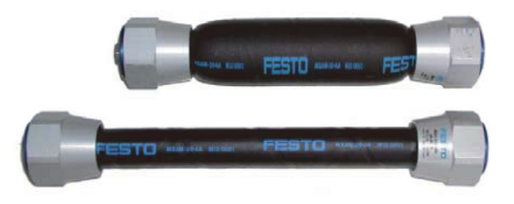
BPA force depends on length, pressure, and contraction
Contracted
Uncontracted
Bolen et al., Actuators 15(5):230 · Hunt, INRC (2019), slide 49
5
Notes:
Inflation changes the actuator’s length and diameter. The two photographs establish contracted and uncontracted states. Our rig measures force and pressure at controlled lengths. First, consider how resting length affects the maximum available force.
Sources: Bolen et al., Actuators 15(5):230 · Hunt, INRC (2019), slide 49

Slide 6


Shorter BPAs deliver less maximum isometric force
Resting length changes the force available to a robot design
Bolen et al. (2026), Actuators 15(5):230 · Dissertation Ch. 3
6
Notes:
At 620 kPa, shorter actuators produce less maximum force in both tested diameters. The manufacturer prediction has the opposite trend. Resting length therefore needs to enter the force model.
Sources: Bolen et al. (2026), Actuators 15(5):230 · Dissertation Ch. 3

Slide 7


Resting-length scaling completes the normalized force model
Bolen et al., Actuators 15(5):230 · Dissertation Ch. 3
7
Notes:
Both normalized force surfaces use the same pressure colors and symbol conventions. The legend identifies measured points, fitted curves, and manufacturer predictions. Multiplying normalized force by the resting-length force scale gives the complete model. The next slide shows its practical effect at 112 mm.
Sources: Bolen et al., Actuators 15(5):230 · Dissertation Ch. 3

Slide 8
At 112 mm, the new model reduces force error to 4.5%
10 mm BPA · 112 mm resting length · 620 kPa
Bolen et al. (2026), Actuators 15(5):230 · Dissertation Ch. 3
8
Notes:
The measured force is 350.9 N, compared with 335.3 N from the new model and 498.6 N from the manufacturer. Bars use the force axis; diamonds use the right error axis. The published errors are 4.5% and 42.1%. These are prediction errors, not uncertainty intervals.
Sources: Bolen et al. (2026), Actuators 15(5):230 · Dissertation Ch. 3

Slide 9
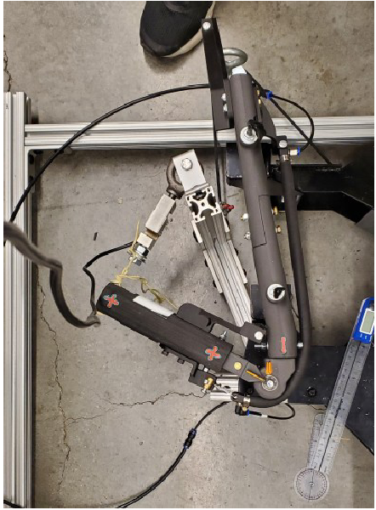
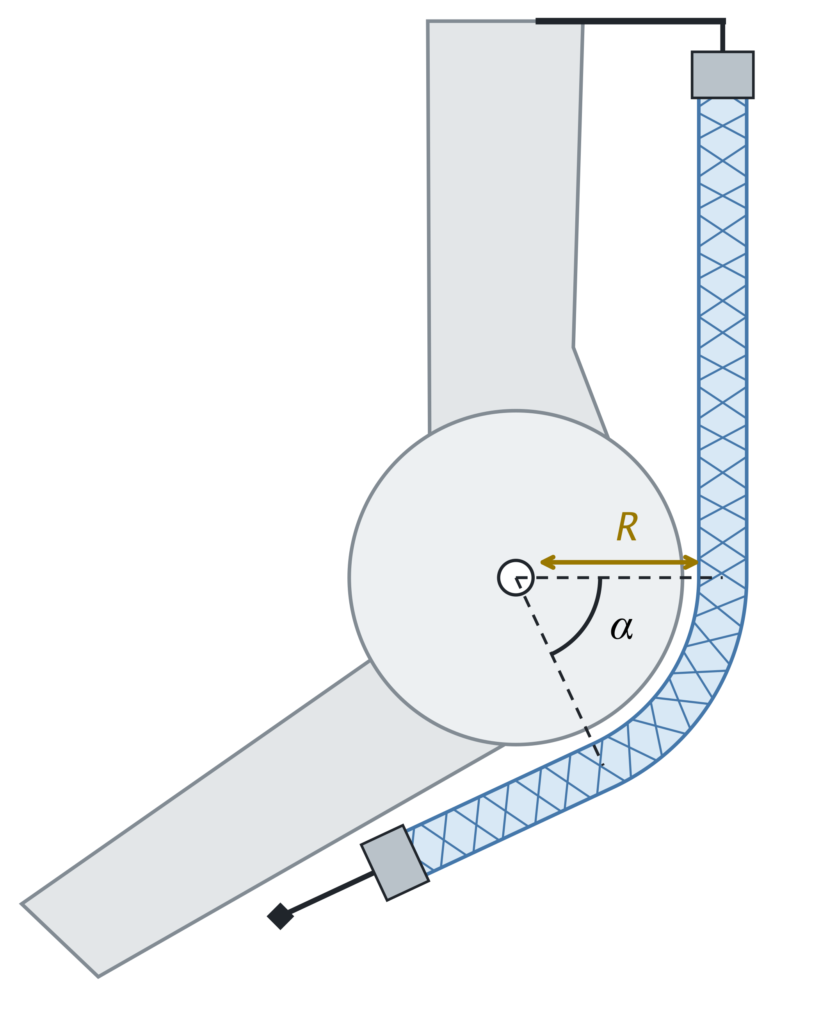
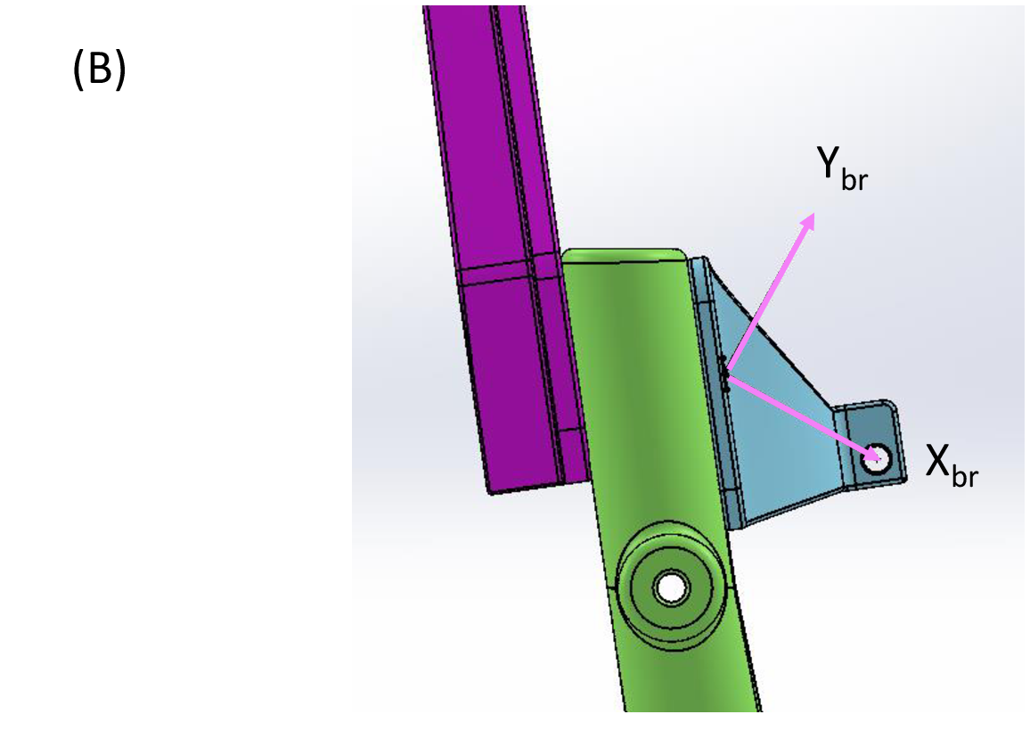
Length offsets, compliance, and wrapping change predicted joint torque
χ₀
χ₁, χ₂
χ₃
Unloaded length offset
Effective system stiffness
Wrapping length loss
Dissertation Ch. 4 · Length correction and effective attachment mechanics
9
Notes:
Actuator force depends on usable muscle length. Chi-zero corrects an unloaded length offset. Chi-one and chi-two represent effective system stiffness, including fixtures and the loading path. Chi-three scales wrapping-related length loss. Held-out torque curves test the resulting model.
Sources: Dissertation Ch. 4 · Length correction and effective attachment mechanics

Slide 10
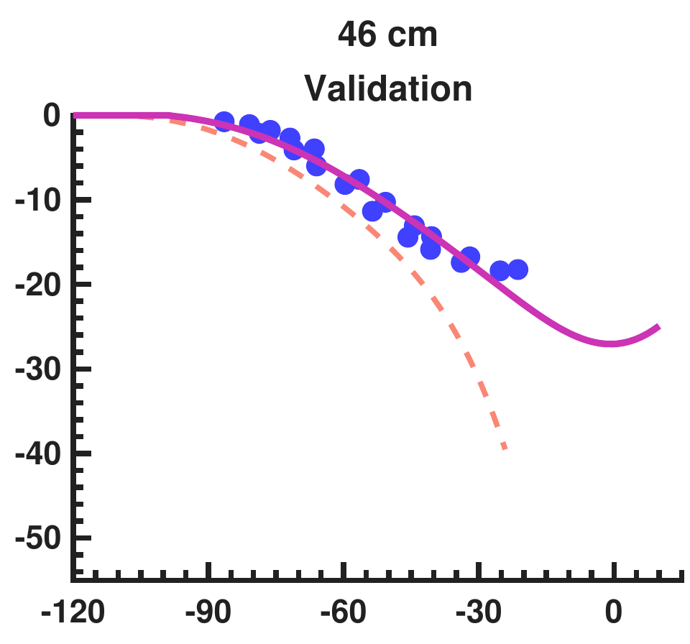
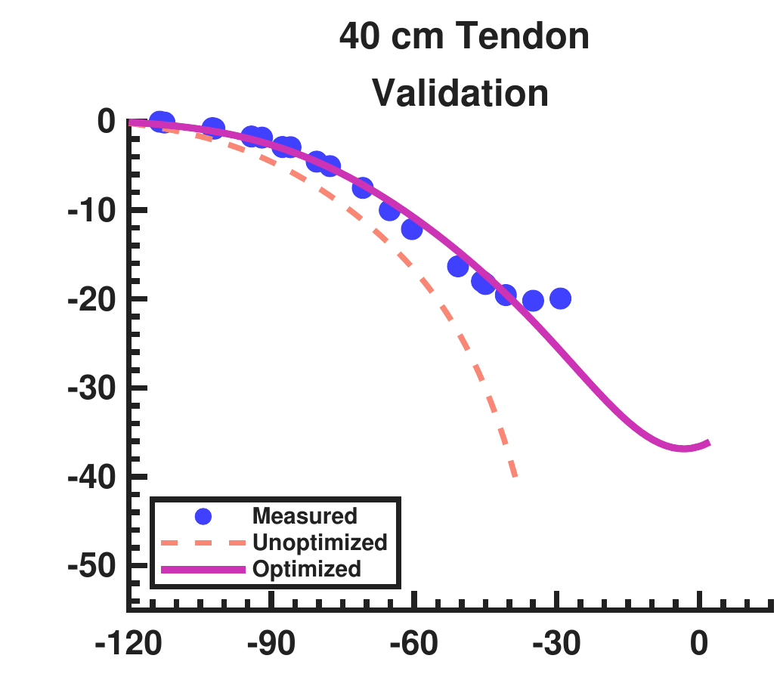
Design corrections reduce error on held-out knee tests
Torque, N m
(C)
(D)
Knee angle, deg
Held-out mean RMSE: 7.588 to 1.490 N m
Dissertation Ch. 4 · Current knee-torque manuscript, §§3–4
10
Notes:
These are the held-out 46 cm and 40 cm-tendon flexor tests. The full model uses the shared effective stiffness pair. Its validation mean RMSE is 1.490 N m. With a better transmission model, we can redesign the route against a human torque target.
Sources: Dissertation Ch. 4 · Current knee-torque manuscript, §§3–4

Slide 11

The corrected model predicts a cam route with torque headroom
+30.83% above required envelope · 269–507 kPa predicted pressure
Dissertation Ch. 4 · Current knee-torque manuscript, §§3–4
11
Notes:
The adopted cam route predicts at least 30.83% margin above the required envelope, which includes 5% overshoot. The predicted pressure requirement is 269–507 kPa. The next comparison tests the built route.
Sources: Dissertation Ch. 4 · Current knee-torque manuscript, §§3–4

Slide 12

All nine cam-route measurements exceed the selected human target
Two 20 mm BPAs
9 of 9 human targets met
Dissertation Ch. 4 · Physical extensor tests
12
Notes:
All nine extensor measurements exceed the selected human target. Keep the measured blue points separate from the pressure-specific and 620 kPa predictions. The point near −86.5° remains above the human target; its 2.06 N m discrepancy concerns the pressure-specific prediction.
Sources: Dissertation Ch. 4 · Physical extensor tests

Slide 13
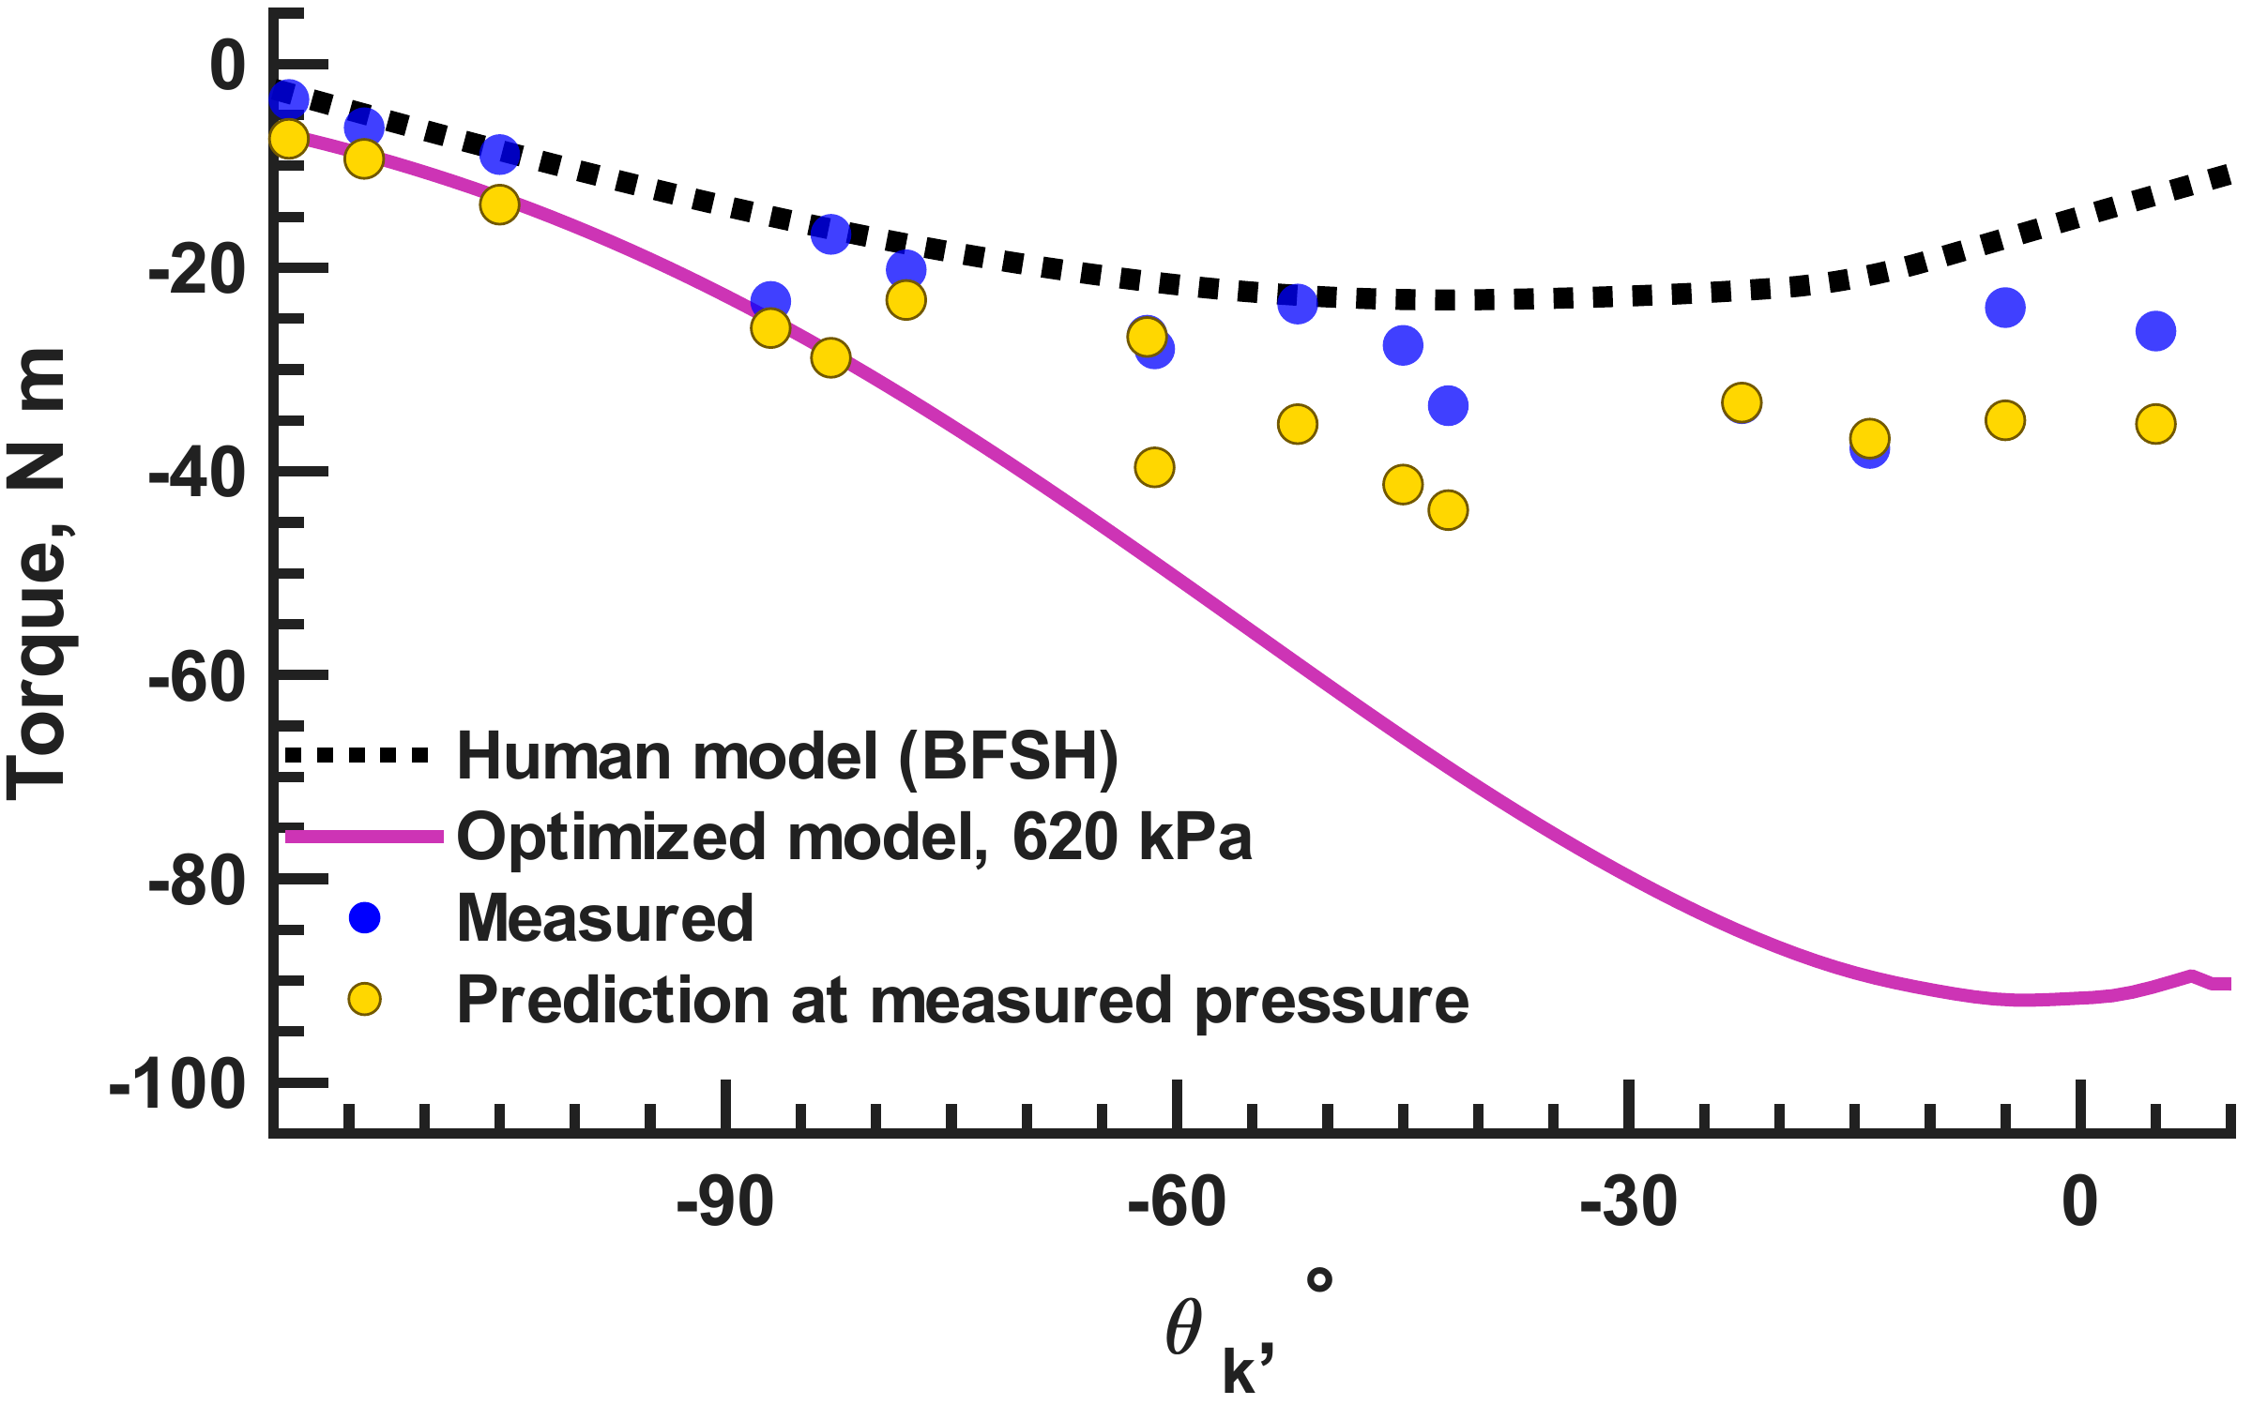
All fifteen flexor measurements meet the human target
15 of 15 targets met · 226.5–638 kPa · negative torque denotes flexion
Dissertation Ch. 4 · Current knee-torque manuscript, §§3–4
13
Notes:
All fifteen flexor measurements meet or exceed the selected human target from −119° to +5°. Flexion torque is negative, so compare magnitudes. The points establish isometric capacity, while the variable-pressure measurements and nominal prediction curve describe different conditions.
Sources: Dissertation Ch. 4 · Current knee-torque manuscript, §§3–4

Slide 14
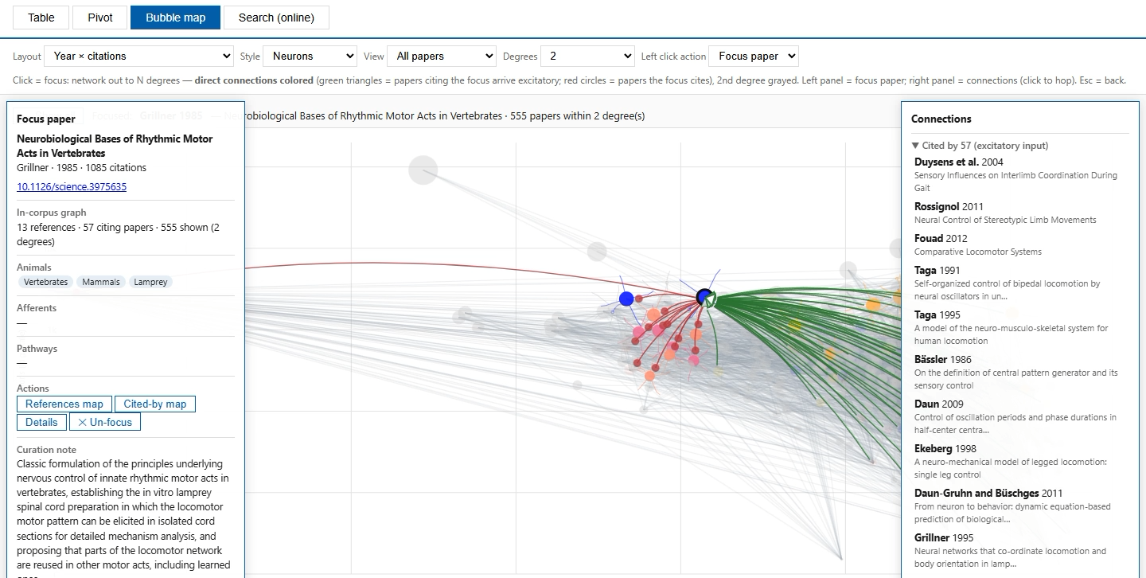
SADb makes sensory evidence searchable and traceable
Open offline SADb
Search · inspect · follow · compare
SADb Explorer · Offline snapshot: 1,393 records
14
Notes:
SADb retains experimental context when searching sensory evidence. Demonstrate search, record details, citation navigation, and pivot drill-through. The embedded walkthrough works offline. The link opens the full app. Table contains 1,393 records; Pivot and Bubble map use the 943-entry Papers category. External links and online search need a connection.
Sources: SADb Explorer · Offline snapshot: 1,393 records

Slide 15

Suspended leg motion does not establish weight-bearing walking
Suspended
Released
Native recording pending
Native recording pending
1 · W2L walker and controller · Dissertation Table 6.1
15
Notes:
Compare the original walker while suspended and after release. Leg motion alone does not establish weight-bearing behavior. This motivates tools that separate neural activity, sensory feedback, and mechanical support. Continue with the W2L feedback comparison.
Sources: AnimatLab walker · Original model and controller

Slide 16
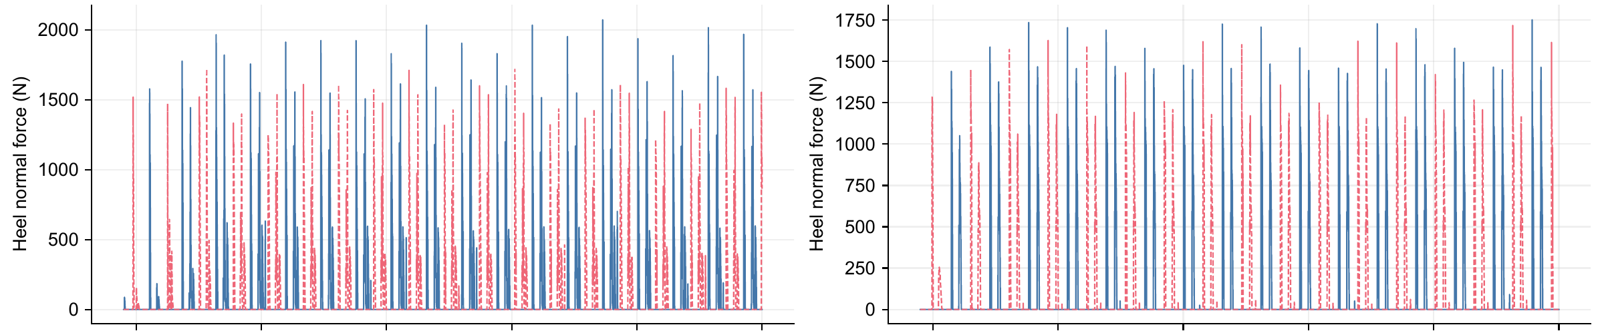
Sensory feedback changes bilateral foot-loading timing
Left leg: solid · Right leg: dashed
5
10
15
20
25
30
5
10
15
20
25
30
Time (s)
Time (s)
Feedback intact: 0.498 cycle
Feedback disabled: 0.223 cycle
1 · W2L walker and controller · Dissertation Table 6.1
16
Notes:
With controller, drive, and support held fixed, sensory feedback changes median bilateral loading phase from 0.223 to 0.498 cycles. The supported-stepping criterion is 0.35–0.65. The result identifies a role for feedback in coordination.
Sources: Dissertation Ch. 6 · Fixed-controller sensory comparison

Slide 17
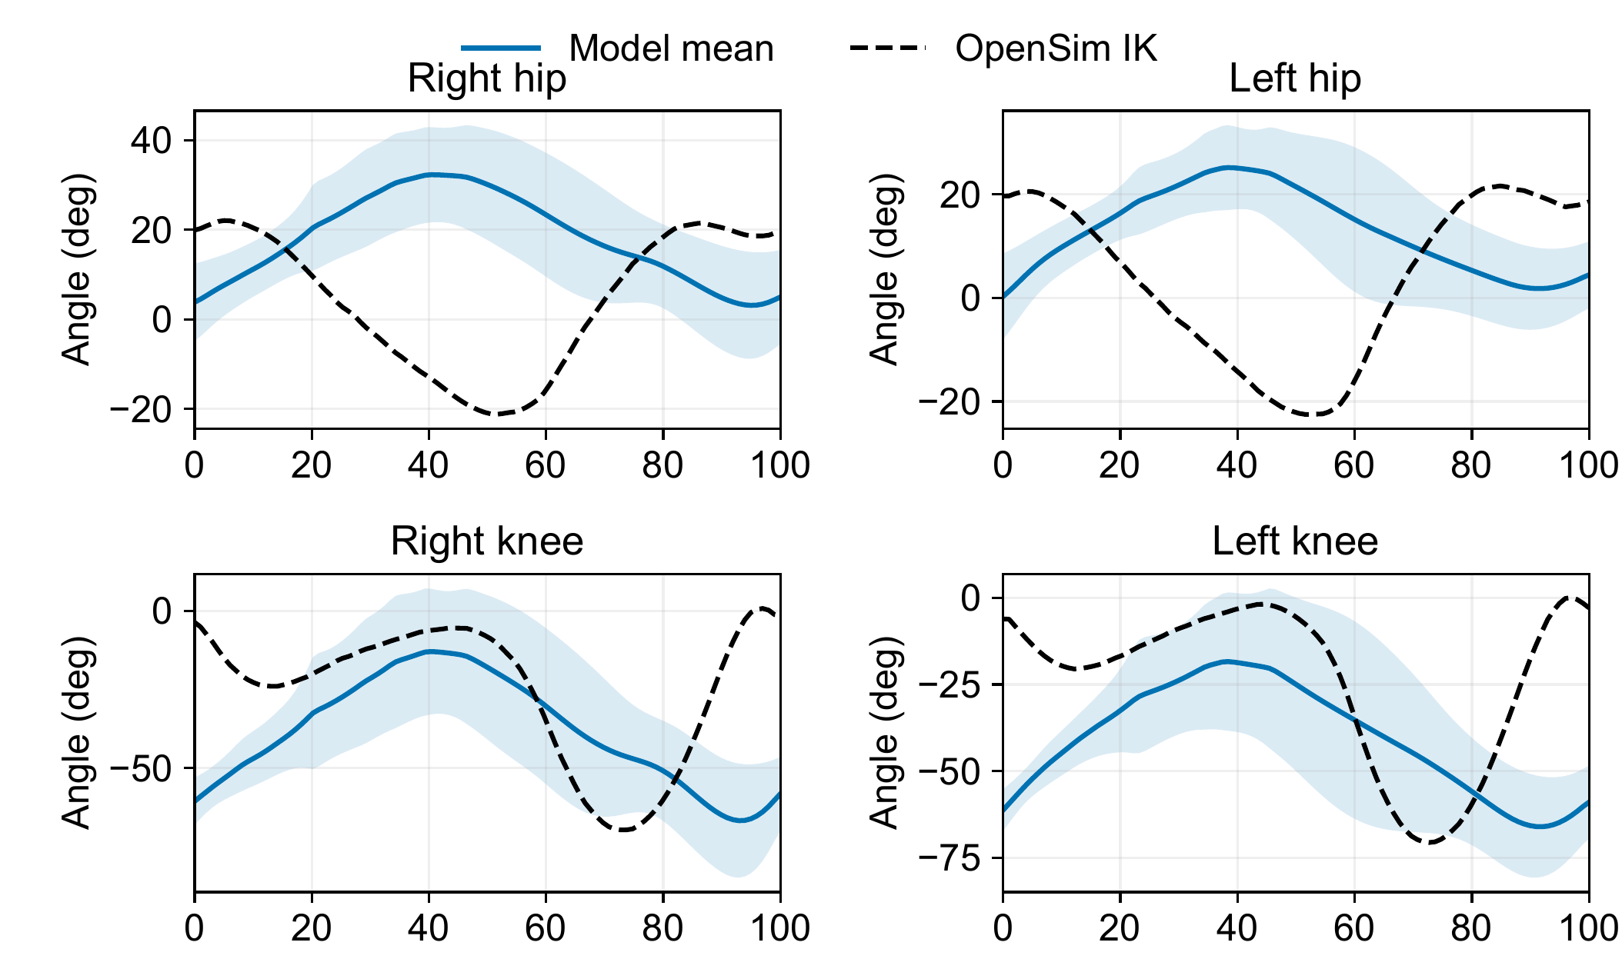
Rhythmic Gait2392 cycles retain hip and knee errors
Hip timing differs
Knee timing differs
No fitted phase shift
or amplitude scaling
Gait cycle, %
10 cycles per leg · stance fractions 0.71 / 0.65 versus reference 0.61
2 · Gait2392-based models · Dissertation Table 6.1
17
Notes:
The Gait2392 reference provides a second model comparison. Hip and knee traces expose differences that rhythmic cycles alone would miss. Preserve the source alignment and compare waveform, excursion, and timing. The complete eight-panel comparison is on question slide 39.
Sources: Dissertation Ch. 6 and Appendix D · Current saved verification records

Slide 18
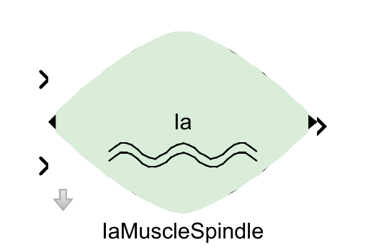
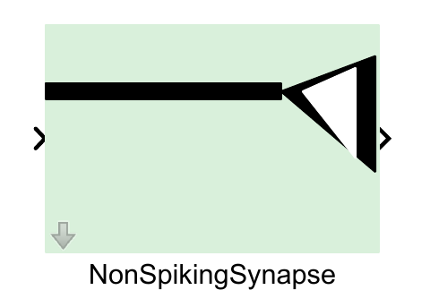
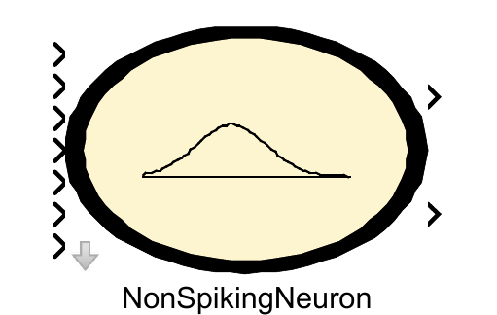
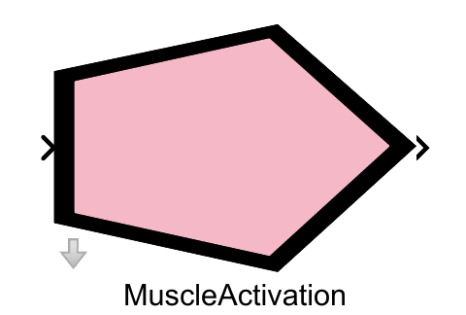
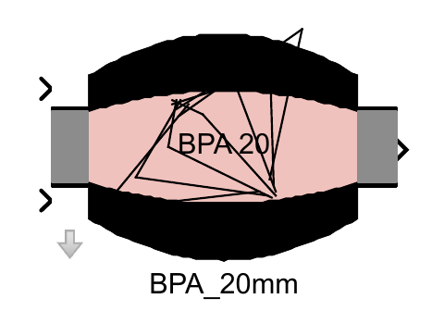
Graphical blocks close the loop between muscle mechanics and neurons
Ia feedback
Synaptic current
Motoneuron
Activation
BPA force
Muscle length and velocity return through the coupled model
3 · SNS-Simscape blocks and editor · Dissertation Table 6.1
18
Notes:
The graphical library supplies the components for a sensory pathway: spindle output, synaptic current, a motoneuron, activation, and BPA force. The coupled mechanical model returns muscle length and velocity. The loaded-arm example tests whether such feedback changes a mechanical response.
Sources: SNS-Simscape library · Dissertation Table 6.1, third contribution

Slide 19
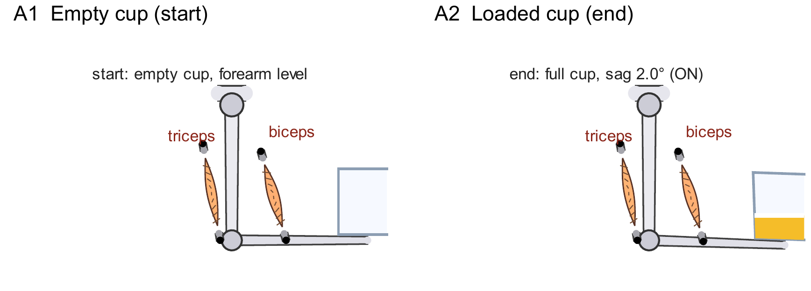
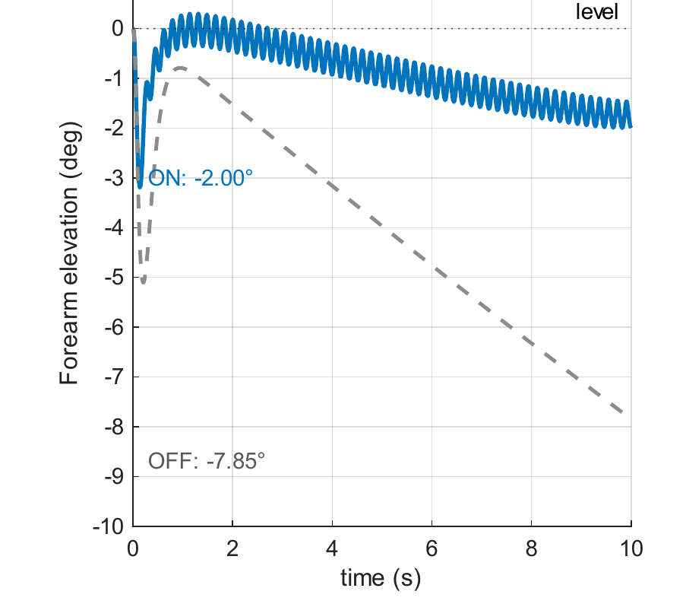
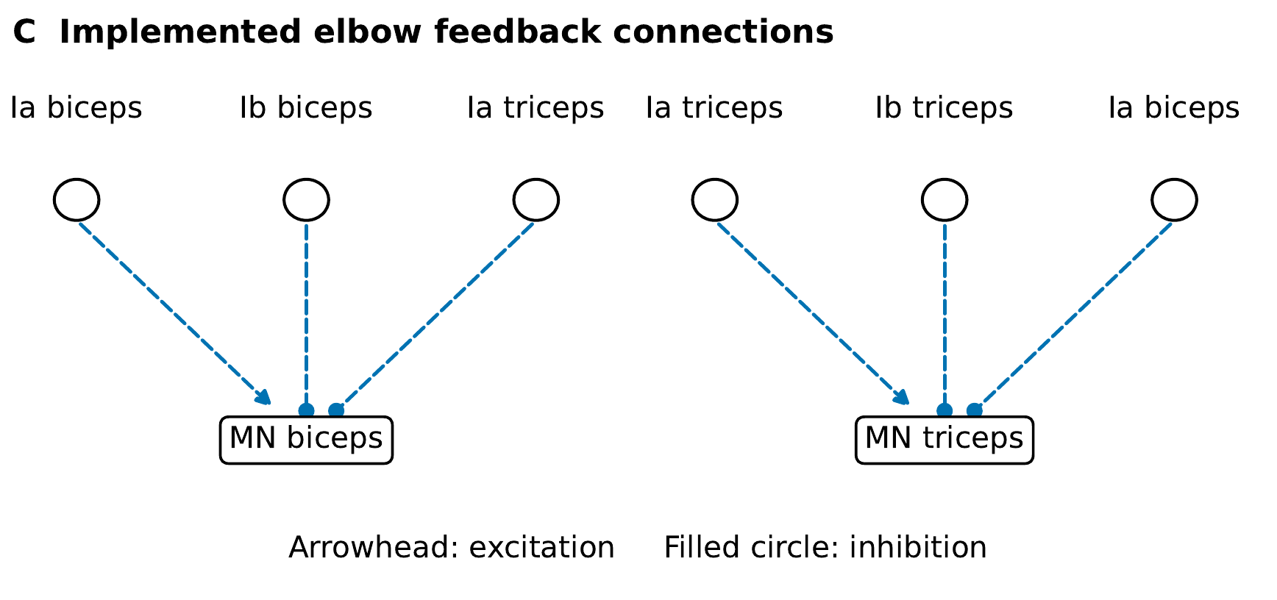
Sensory feedback reduces sag in the loaded-arm model
B Feedback on/off
Sag: 2.00° with feedback · 7.85° without feedback
3 · SNS-Simscape blocks and editor · Dissertation Table 6.1
19
Notes:
With feedback, the loaded arm sags 2.00°, compared with 7.85° without it. Biceps Ia excites its own motoneuron and inhibits the antagonist; own-muscle Ib is inhibitory. The circuit and the matched traces show the implemented feedback effect.
Sources: Dissertation Ch. 6 and Appendix D · Current saved verification records

Slide 20

Extra abductor control prevents crossing in the AH001 test
15–40 s | Off | On
Crossed states | 67% | 0%
Min. spacing | −38.3 mm | 142.4 mm
54 reference-tension actuators; 80% vertical + lateral/angular assistance
MN clamp cancels PF/reflex currents; regular stepping unverified
4 · CAD-derived robot model · Dissertation Table 6.1
20
Notes:
In the supported AH001 comparison, extra abductor control removes crossed states and increases minimum separation. The model uses reference tensions, 80% vertical assistance, lateral/angular support, and an MN clamp that cancels PF/reflex currents. This diagnostic does not establish accepted regular stepping. Question slide 33 collects the model assumptions.
Sources: Dissertation Ch. 6 and Appendix D · Current saved verification records

Slide 21
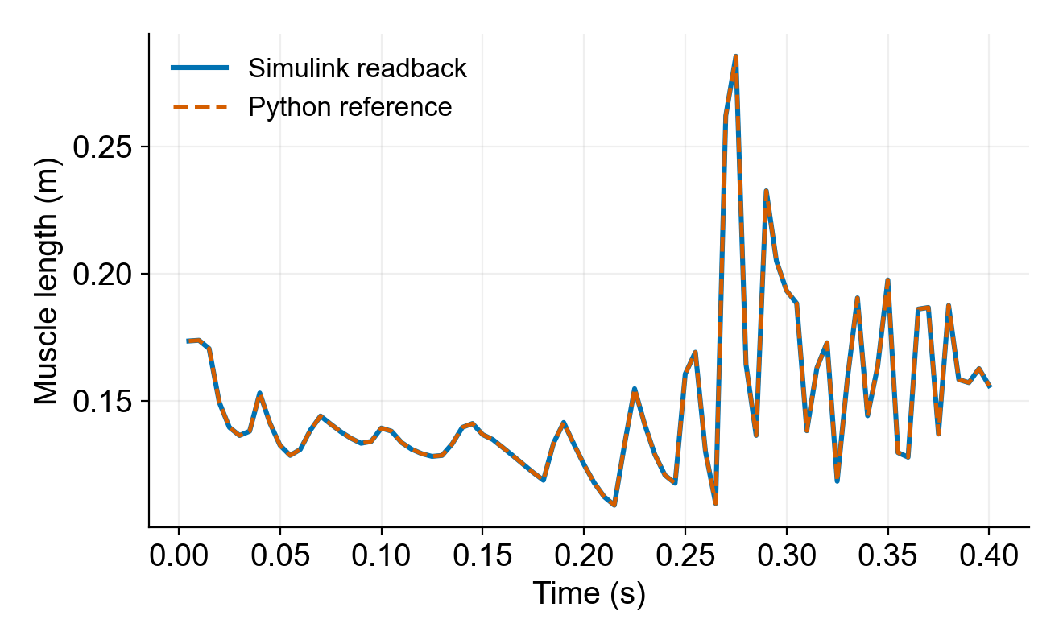
The MuJoCo–Simulink bridge preserves measured signals
SNS-Simscape
controller
Activation
commands
Sensory
measurements
MuJoCo
mechanical model
5 sensor channels · 80 scored steps · maximum deviation 0
5 · MuJoCo–Simulink integration · Dissertation Table 6.1
21
Notes:
The bridge exchanges activation commands and sensory measurements. In the saved interface test, all five sensor channels match the Python reference bit for bit over 80 scored steps. The displayed muscle-length traces show that agreement over 0.4 s. Controlled experiments then test the coupled behavior.
Sources: Dissertation Ch. 6 · Saved bridge sensor-readback test

Slide 22
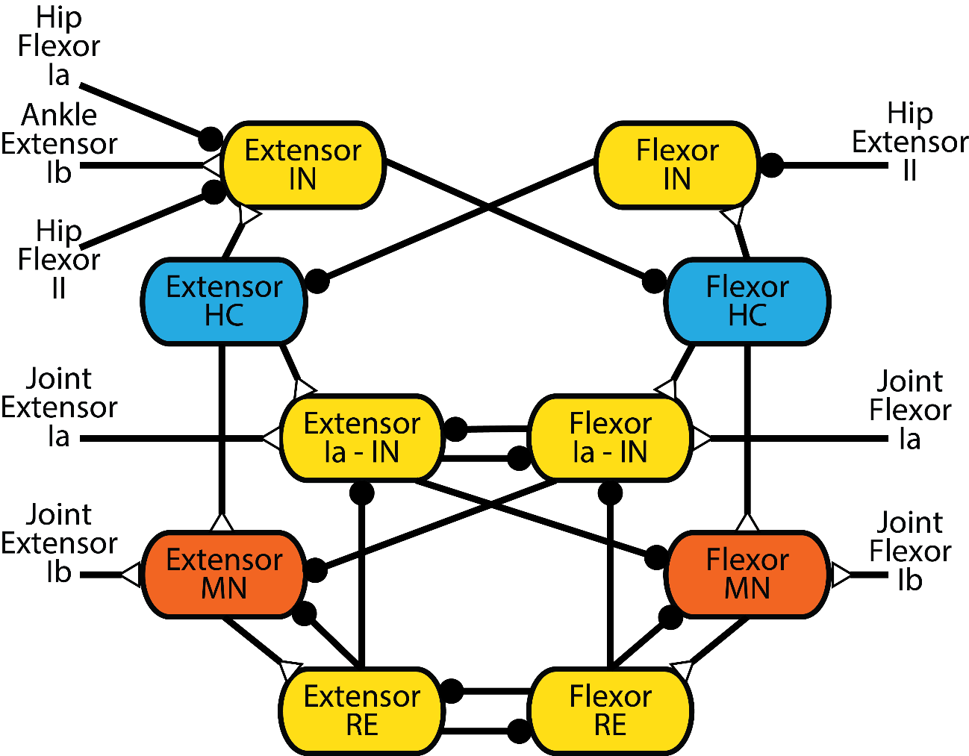
The tools make each of Hunt’s four training steps observable
1
Set intrinsic CPG rhythm
SNS blocks and open-loop traces
2
Train feedback → CPG
Afferent playback and timing
3
Train CPG/PF → MN
Motor-neuron peak comparisons
4
Refine Ia/Ib → MN
Closed-loop pathway tests
6 · Curriculum and experiment drivers · Dissertation Table 6.1
22
Notes:
Hunt’s four steps specify where training acts: intrinsic rhythm, feedback to the CPG, CPG/PF output to motoneurons, and Ia/Ib feedback to motoneurons. The tools expose the activity and mechanical response needed to assess each step.
Sources: Hunt, INRC presentation (2019), slide 44 · Dissertation Ch. 6

Slide 23
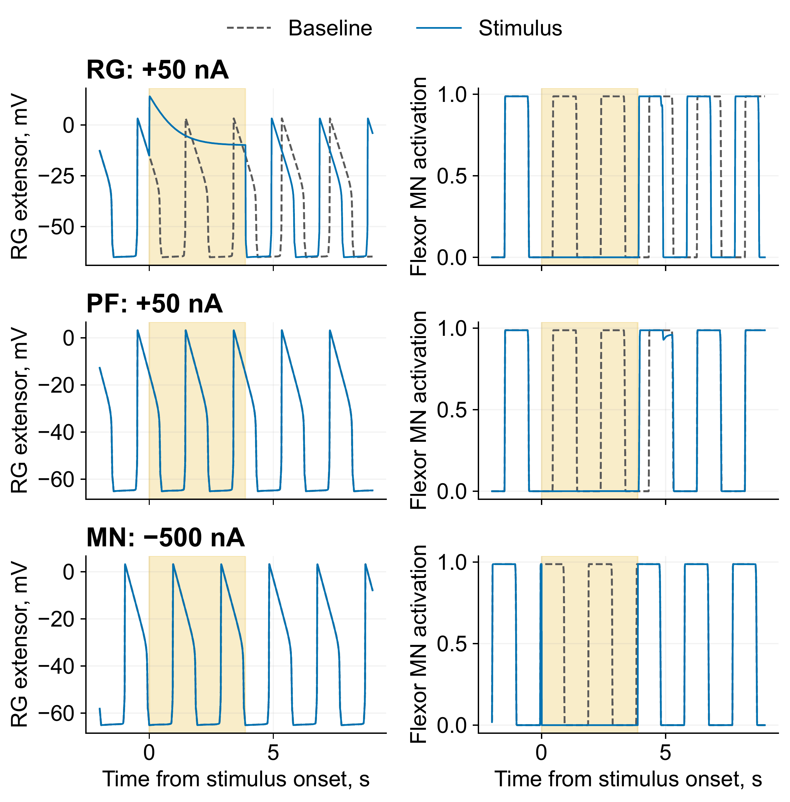
Two deleted bursts can preserve or reset the rhythm
Stimulated layer | RG shift, cycles
RG | 0.211
PF | 0.000
MN | 0.000
RG: rhythm generator
PF: pattern formation
MN: motor neuron
Reduced Deng-derived circuit · two baseline periods · suspended model
7 · Literature circuits and variants · Dissertation Table 6.1
23
Notes:
The reduced Deng-derived circuit suppresses two expected motor bursts at each tested layer. RG stimulation shifts the clock by 0.211 cycle. PF and MN stimulation suppress output without resetting the RG clock. Read neural timing and motor output together when interpreting a deletion.
Sources: Dissertation Ch. 6 and Appendix D · Current saved verification records

Slide 24
Researchers can connect source evidence to a tested actuator or pathway
Select an actuator
Test a route
Trace a sensory hypothesis
Test a pathway
Dissertation Chs. 3–7
24
Notes:
These contributions enable research decisions: select an actuator, test a route against a target, recover the context for a sensory hypothesis, and test the corresponding pathway. Each step has an identifiable source and an observable outcome.
Sources: Dissertation Chs. 3–7

Slide 25
The next experiments must transfer the models to loaded robot movement
Dynamic loading and physical transfer
Graded support reduction
Dissertation Discussion · Future work enabled
25
Notes:
The next experiments add dynamic loading to the hardware, reduce support in controlled stages, and transfer specified feedback mechanisms to the robot. These experiments address movement in unstructured environments and the use of robots to study biological hypotheses.
Sources: Dissertation Discussion · Future work enabled

Slide 26
The dissertation makes actuator, route, and feedback choices testable
Predict force
Meet selected torque targets
Ground sensory hypotheses
Test neural mechanisms
Thank you · Questions
Dissertation Conclusion
26
Notes:
The dissertation makes actuator, route, and feedback choices testable. It supplies force characterization, joint design factors with physical target comparisons, a sensory evidence resource, and tools for controlled neural–mechanical experiments. Thank the committee and audience.
Sources: Dissertation Conclusion

Slide 27
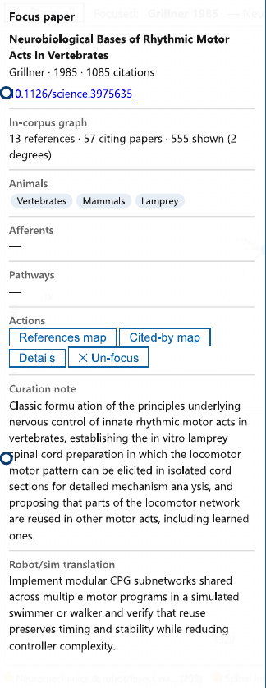
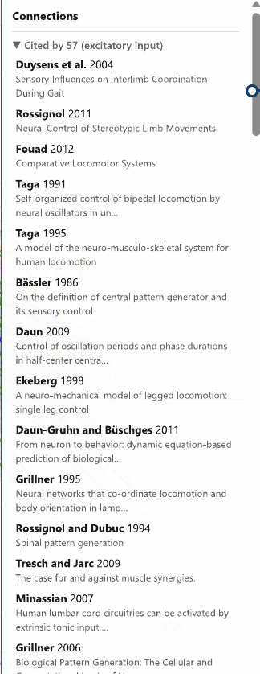
SADb keeps experimental context beside the proposed robot interpretation
Source and
experimental context
Robot interpretation
to test
Dissertation Ch. 5 · Focus record and connected sources
27
Notes:
One SADb record keeps source context beside the proposed robot interpretation. The interpretation is a hypothesis to test. Connected sources help check that interpretation before selecting a pathway or parameter.
Sources: Dissertation Ch. 5 · Focus record and connected sources

Slide 28
Joint torque depends on force direction and moment arm
p
F
τz = (r × F) · ẑ
r⊥
r
|τz| = F r⊥
O
Routing also changes
actuator length
A force model needs a transmission model to predict delivered torque
Dissertation Ch. 4 · Current knee-torque manuscript, §§3–4
28
Notes:
Torque follows the cross product of the attachment position and tensile force. Its magnitude is force times perpendicular moment arm. Changing a route also changes actuator excursion, so moment arm alone is insufficient.
Sources: Dissertation Ch. 4 · Current knee-torque manuscript, §§3–4

Slide 29
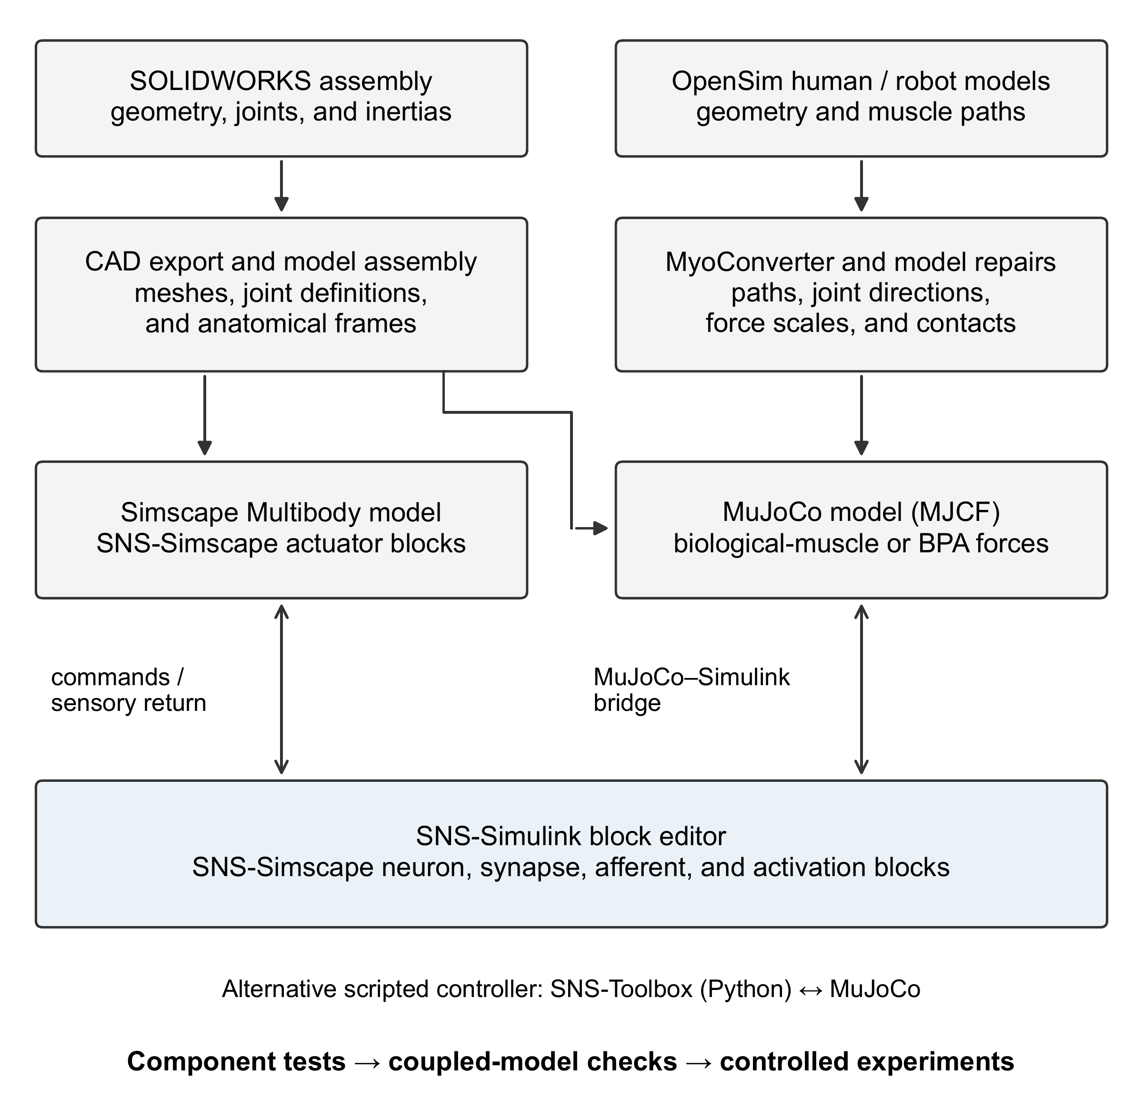
The model workflow supports distinct mechanical implementations
Command exchange, circuit agreement, and motion each require their own check
Dissertation Ch. 6, Model construction and neural-controller interfaces
29
Notes:
The workflow separates CAD/Simscape construction from OpenSim/MuJoCo conversion. Controllers can use graphical SNS blocks or SNS-Toolbox. Each implementation needs component, interface, and coupled-model checks.
Sources: Dissertation Ch. 6, Model construction and neural-controller interfaces

Slide 30
Staged tests separate rhythm, feedback, and mechanical support
Condition introduced | Question tested
Suspended, without sensory feedback | Can the circuit generate activity?
Sensory feedback | How does feedback reshape the output?
Standing and perturbations | Can the model maintain posture?
Supported ground contact | Does physical coordination meet the criterion?
Reference and intervention comparisons | Which mechanism or mismatch explains the result?
Dissertation Ch. 6, curriculum Table 6.2
30
Notes:
The curriculum introduces feedback, perturbations, and mechanical demands in stages. Each stage asks a different question. Passing a rhythm test does not establish performance at the later mechanical stages.
Sources: Dissertation Ch. 6, curriculum Table 6.2

Slide 31

Matched rhythm cores reproduce the same driven bursts
1.000 s period · 10 expected bursts · correlation ≥ 0.99996
Dissertation Ch. 6 and Appendix D · Current saved verification records
31
Notes:
Under the matched phasic-drive protocol, both implementations produce the ten expected bursts with a 1.000 s period and correlation of at least 0.99996. Removing those phasic inputs latches both. The result establishes agreement for this defined core and protocol.
Sources: Dissertation Ch. 6 and Appendix D · Current saved verification records

Slide 32
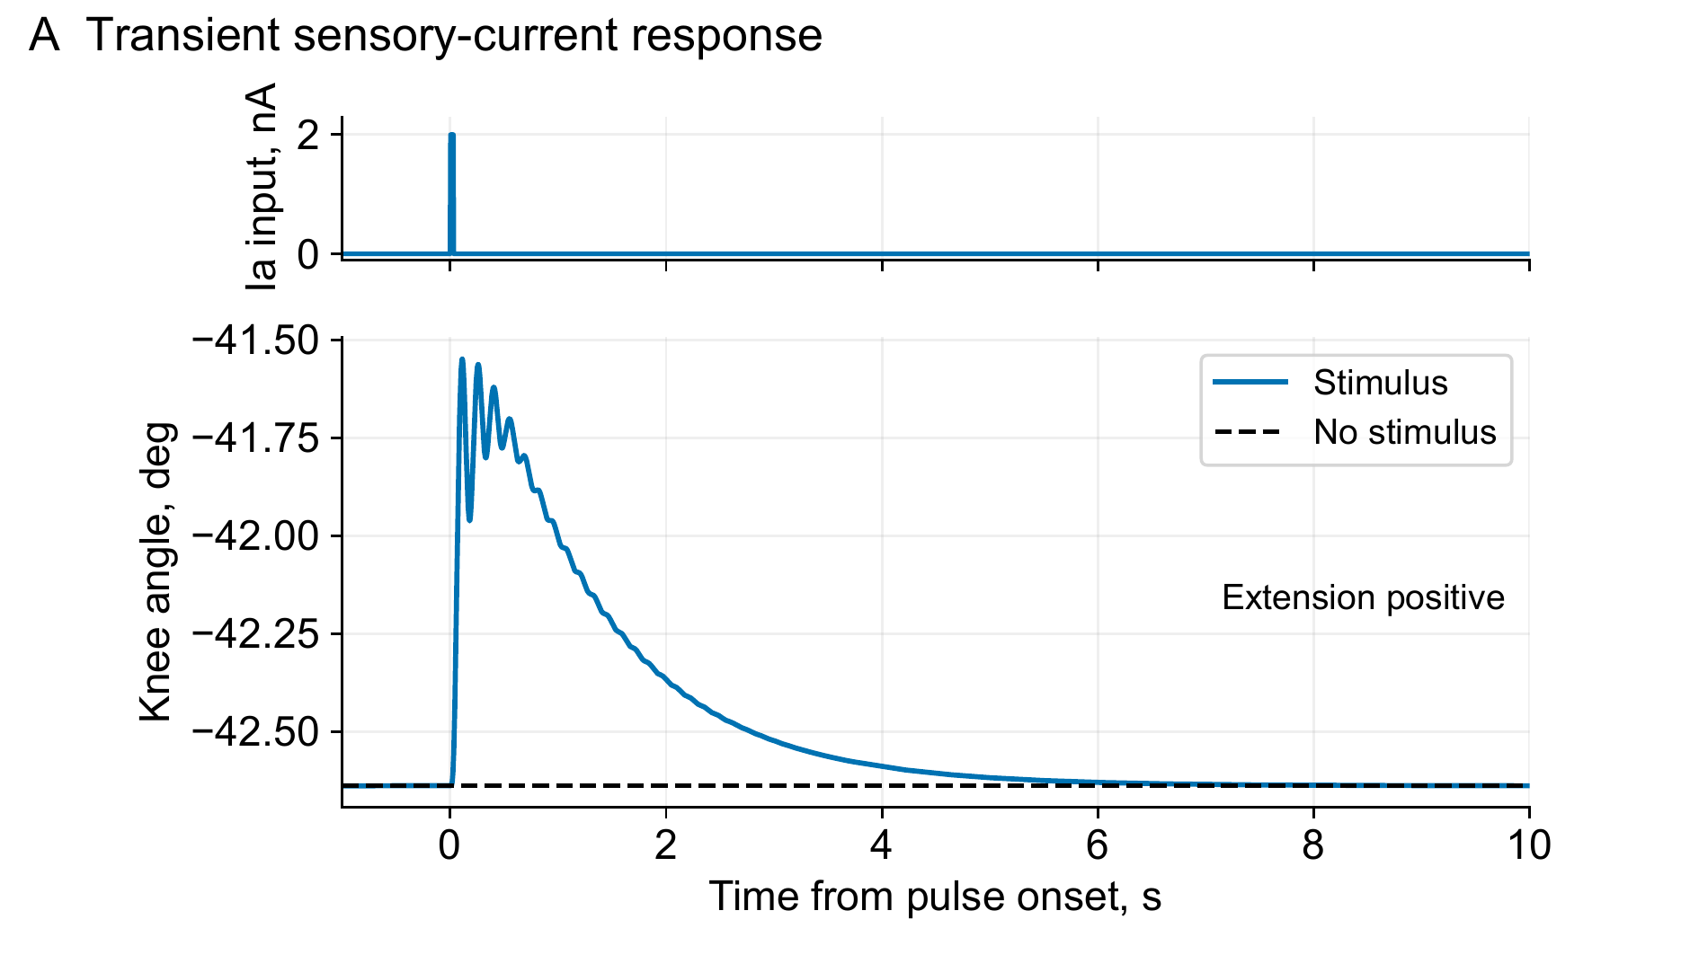
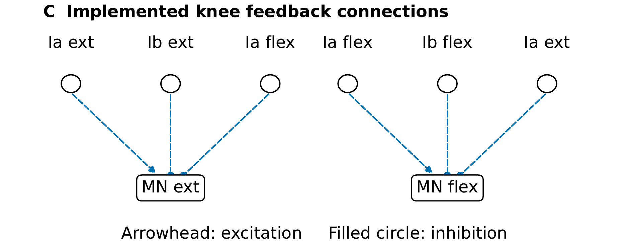
The knee model produces a transient sensory response
2 nA for 30 ms
1.09° at 111 ms
Recovery at 6.355 s
Six neural saturation widths changed in this configuration
Dissertation Ch. 6 and Appendix D · Current saved verification records
32
Notes:
The knee example applies 2 nA for 30 ms after settling. The response peaks at 1.09° at 111 ms and meets the recovery thresholds at 6.355 s. Six neural saturation widths changed. This is an engineering demonstration of the implemented blocks.
Sources: Dissertation Ch. 6 and Appendix D · Current saved verification records

Slide 33
The evidence establishes specific capabilities within clear limits
Evidence level | What the result establishes | Remaining boundary
Measured hardware | Isometric torque capacity | Dynamic response and transfer
Neural demonstrations | Specified response and intervention effect | Circuit- and protocol-specific
Supported W2L / human models | Coupling and coordination tests | External support remains
AH001 integration | Hybrid allocation; PF/reflex currents cancelled | 80% vertical + lateral/angular support
AH001: reference tensions, MN clamp, provisional feet, and ideal brackets
No harness-free walking has been demonstrated
Current manuscript Ch. 6 / Appendix D · Session 1 AH001 records
33
Notes:
The hardware demonstrates isometric capacity. Neural interventions demonstrate responses under their specified protocols. Supported models test coupling and coordination. AH001 retains the stated support, reference tensions, provisional feet, ideal brackets, and hybrid clamp. No harness-free walking has been demonstrated.
Sources: Current manuscript Ch. 6 / Appendix D · Session 1 AH001 records

Slide 34
The adopted identification reserves tests in each configuration
Configuration | Training | Held out | Not used
Pinned flexor | 2 | 2 | 1
Pinned extensor | 3 | 3 | 3
Shared effective stiffness pair: χ₁ = 39.98, χ₂ = 14.73 kN/m
Dissertation Ch. 4 · Current knee-torque manuscript, §§3–4
34
Notes:
The adopted flexor fold has two training tests, two held-out tests, and one unused test. The extensor fold has three in each category. Both configurations share the effective stiffness pair. These fitted terms aggregate system compliance.
Sources: Dissertation Ch. 4 · Current knee-torque manuscript, §§3–4

Slide 35
Physical dimensions differ from prediction settings
Actuator | Resting length, mm | Tendon length, mm
Flexor 1 | 561 | 28
Flexor 2 | 560 | 30
Extensor 1 | 828 | 92
Extensor 2 | 826 | 85
Prediction inputs: flexor 561.49 / 5.00 mm; extensor 827.74 / ≈92.49 mm
Torque manuscript, Physical Tests · Dissertation Appendix C dimensions
35
Notes:
These rows contain measured resting and tendon lengths. Prediction settings differ and remain identified separately. In particular, retain the nominal 562 mm prediction label rather than replacing it with a measured length.
Sources: Torque manuscript, Physical Tests · Dissertation Appendix C dimensions

Slide 36
Stimulation duration changes the deletion interpretation
Protocol | RG shift, cycles | Motor shift, cycles
RG, two periods | 0.211 | 0.211
PF, two periods | 0.000 | 0.000
MN, two periods | 0.000 | 0.000
PF, one second | 0.000 | 0.208
stimulus_results_all.csv · Current Appendix D layer-stimulus protocols
36
Notes:
Stimulus duration matters. The two-period PF pulse gives a non-resetting deletion, while a one-second PF control shifts motor timing by 0.208 cycle with no RG shift. Motor phase alone cannot identify an RG reset.
Sources: stimulus_results_all.csv · Current Appendix D layer-stimulus protocols

Slide 37
AH001 separation control changes a matched diagnostic
15–40 s measure | Control off | Control on
Reversed ankle ordering | 67% | 0%
Minimum separation | −38.3 mm | 142.4 mm
Right TFL mean activation | 22.3% | 81.8%
Vertical assistance | 80% BW | 80% BW
Sampled opposite-leg penetration | 2.700 mm | 0 mm
AH001_20261028/PLACEMENT_RECOMMENDATION.md · asset_provenance.json
37
Notes:
The matched AH001 interval is 15–40 s. The control bundle changes separation feedback and the activation floor on currently abducting routes. Reversed ankle ordering and sampled opposite-leg penetration are distinct measurements. Support remains the same.
Sources: AH001_20261028/PLACEMENT_RECOMMENDATION.md · asset_provenance.json

Slide 38

Reported force comparisons favor the model in the shown cases
Measured-versus-predicted force at the two displayed actuator lengths
Bolen et al. (2026), Actuators 15(5):230 · Dissertation Ch. 3
38
Notes:
The diagonal indicates equality between measured and predicted force. Preserve the model identities and the two tested lengths. These source panels compare the reported cases.
Sources: Bolen et al. (2026), Actuators 15(5):230 · Dissertation Ch. 3

Slide 39
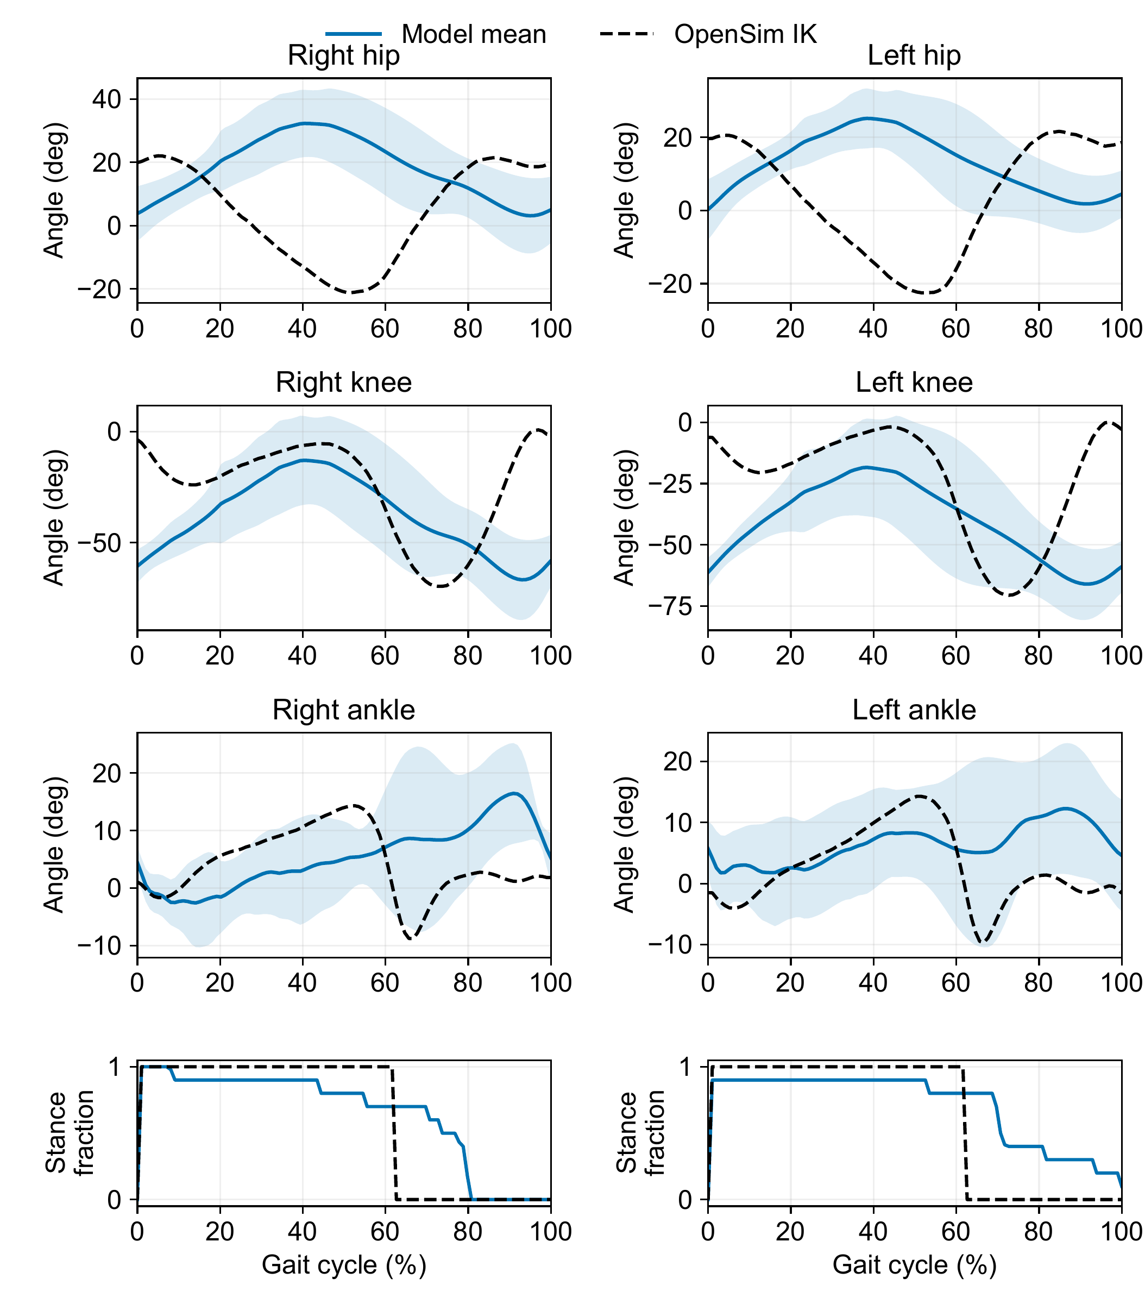
The complete IK overlay also exposes contact differences
Model mean and standard deviation · OpenSim IK reference
Dissertation Ch. 6 and Appendix D · Current saved verification records
39
Notes:
The full IK figure adds ankle and stance comparisons. Each leg is aligned independently to loading onset, without fitted phase or amplitude adjustments. Separate leg alignment does not establish bilateral phase agreement.
Sources: Dissertation Ch. 6 and Appendix D · Current saved verification records

Slide 40

The saved AH001 replay shows supported hybrid motion
Optional 12-second replay · same supported-control diagnostic
AH001_20261028/asset_provenance.json · saved 20–32 s interval
40
Notes:
Play the saved 20–32 s AH001 interval if useful. It illustrates the same supported hybrid-control condition. Use slide 33 for its assumptions and slide 37 for the matched diagnostic measures.
Sources: AH001_20261028/asset_provenance.json · saved 20–32 s interval

Slide 41
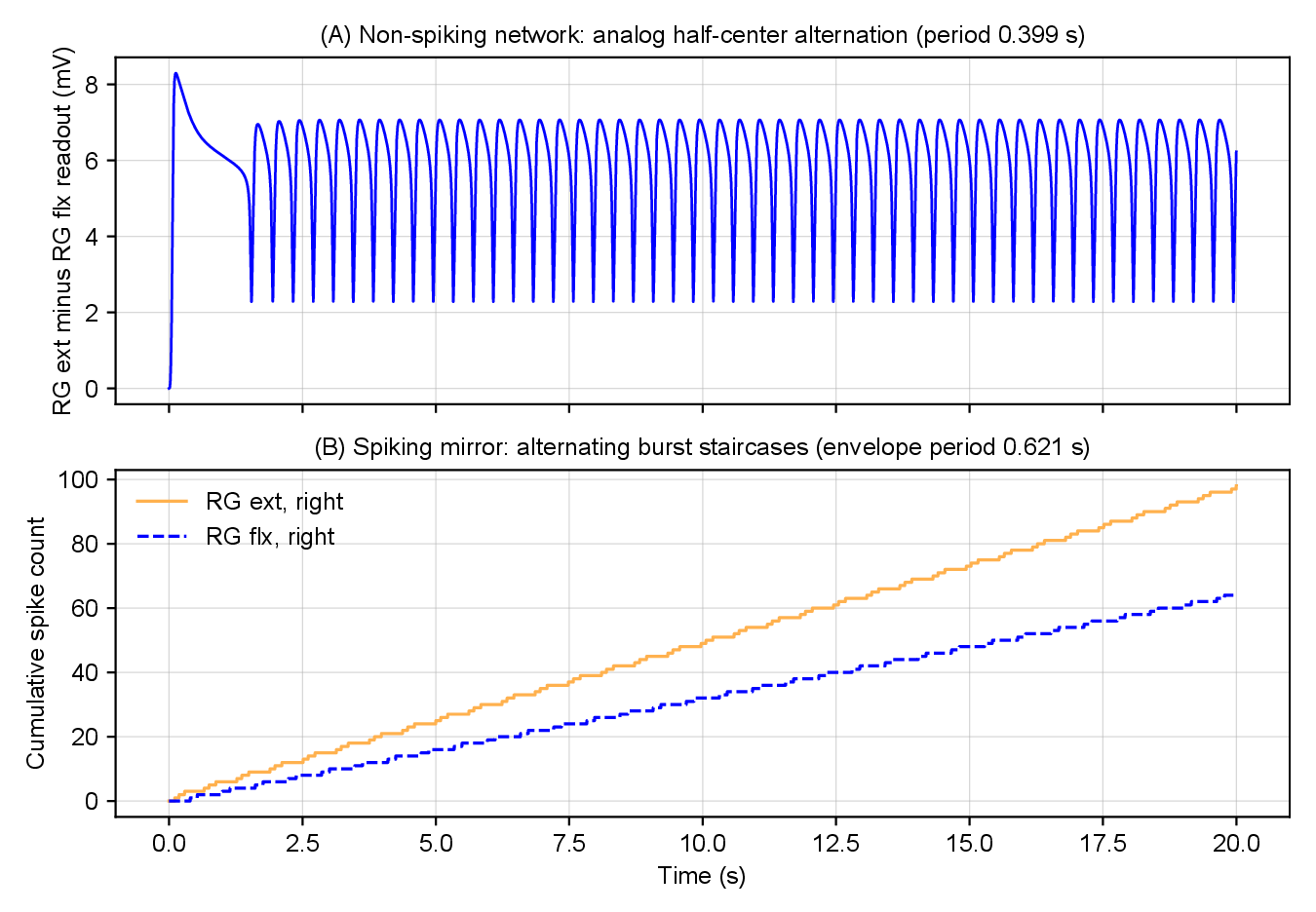
Changing neural encoding changes rhythm timing
0.399 s non-spiking → 0.621 s spiking · 55.6% longer
7 · Literature circuits and variants · Dissertation Table 6.1
41
Notes:
For the saved constant-drive comparison, changing from non-spiking to spiking encoding increases the period from 0.399 s to 0.621 s, or 55.6%. The panels use different readouts. The comparison shows timing sensitivity to encoding choice.
Sources: Dissertation Appendix D · Graded and spiking comparisons

